Slide 1
The way to Handle Objections

Slide 2
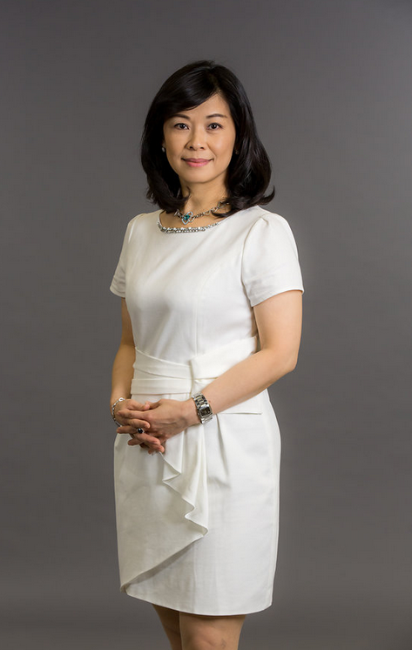
Jane Huang
Executive Director
(earned AUS$25,000-$35,999 in 4 week pay cycle)
Million Dollar Club Member
Market Australia Advisory Council member
Market Australia Certified Trainer
Market Australia Motives Certified Trainer
Melbourne Local Coordinator
Multiple Chairman Challenge Winner
Multiple Top Recruiter of the Year
Multiple Motives Challenge Winner
Multiple Local Challenge Winner

Slide 3





INVESTMENT
(EDUCATION)
Position Yourself for Success
OWN YOUR OWN BUSINESS
ONLINE/MOBILE SHOPPING
SHOPPING ANNUITY

Slide 4
Professional Language
Handling Objections

Slide 5

When it comes to OBJECTIONS…..
It’s not a bad thing
It’s not a rejection
It gives you an opportunity to provide the RIGHT solution

Slide 6
Learn the language of Market Australia
Don’t say this
Instead say this
I do Market America
I own a business
Check out my SHOP.COM portal
Check out my SHOP.COM SITE
There’s a UBP meeting
Tuesday night
There is a business presentation Tuesday night
When do you want to
sign-up/get in?
When would you like to start/register your business?

Slide 7
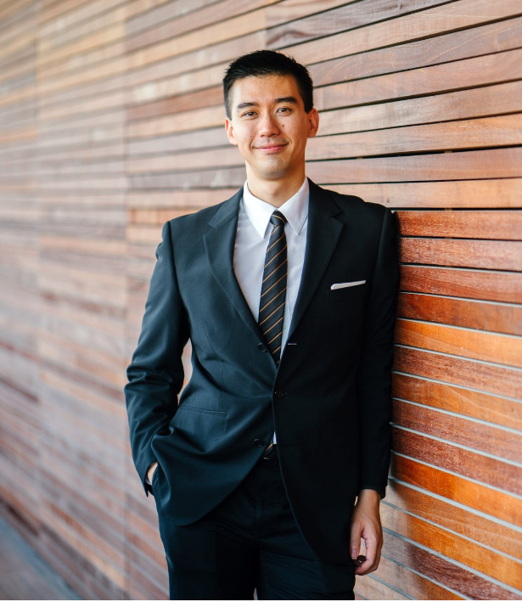
Posture is
everything
when handling
objections!
TRUST

Slide 8
TIPS FOR HANDLING OBJECTIONS
Understand your content
Work with senior business partners
Find their interests
Focus on their” why”
Explore the reason
Clarify their question ( check with the prospect)

Slide 9
is this multi-level marketing?
We ranked 65th on the new 2018 Internet Retailer Top 500
Like any other business we expand our distribution
We took the best of franchising and networking and eliminated the flaws

Slide 10

No
Is this a pyramid?
  Pyramids are illegal
  A pyramid pays for recruiting instead of being based on product sales
This is a legitimate business with a proven track record since 1992
  A+ rating from the Better Business Bureau
  Every corporation’s organizational structure resembles a pyramid

Slide 11
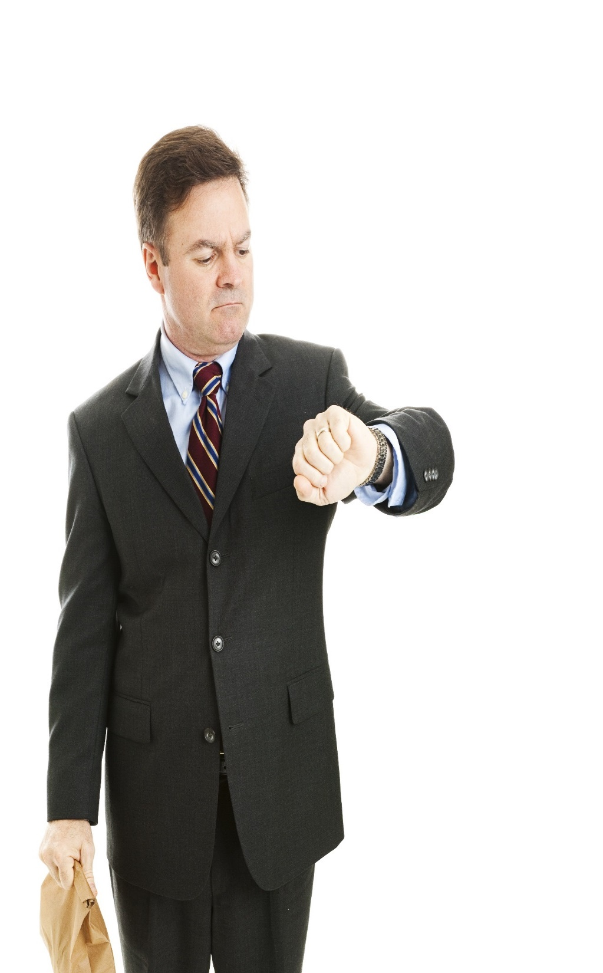
I just don’t have any time
Acknowledge the comment and follow with:
“Today, no one seems to have time with _____”
Agree with the comment and follow with: “Can we get together for coffee? Let me show you the possibility to make both of us mutually profitable ”
“The additional income generated could help create more free time.”

Slide 12

I just don’t have the money
If you are interested and money is the only thing holding you back, let’s set up a product event and generate some sales.

Slide 13
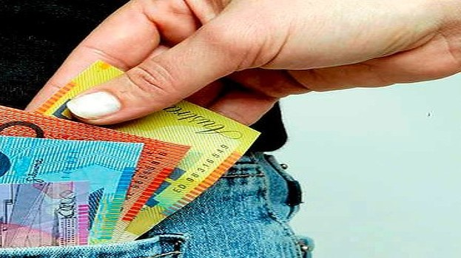

If you are NEW
  I am just getting started
  I already recouped my
  initial investment
  I am earning retail profits, and I am on my way to earning commissions
If you are NOT new
How much are you earning?
Are you making any money yet?
  Initially I was earning retail profits, now I am expanding my team and earning commissions

Slide 14

I have to talk with my spouse
That’s a great idea, would it be possible for the three of us to get together?

Slide 15
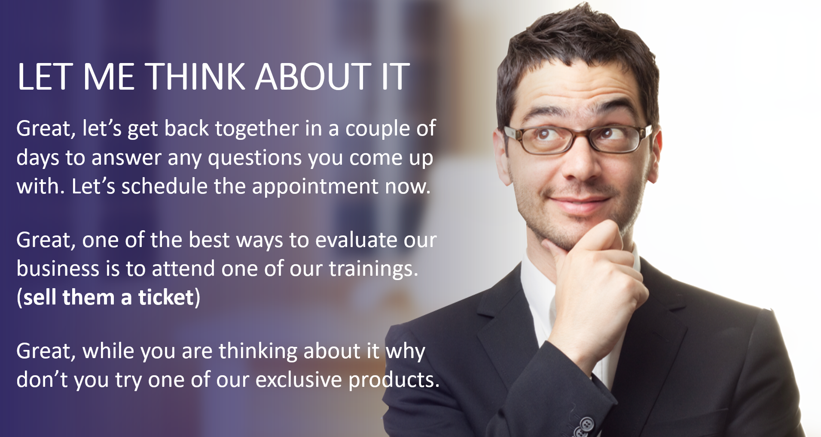

Slide 16
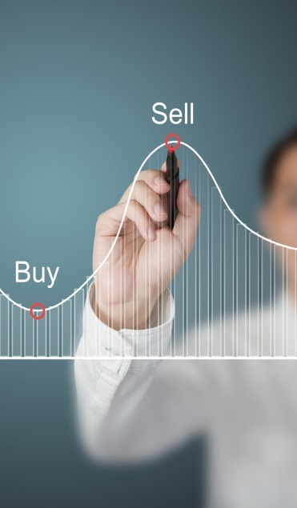
Do I Have To Sell Anything?
Most of the time our products sell themselves
People love our products and find it easy to talk about them
SHOP.COM pays people Cashback on purchases when they shop at their favorite online stores

Slide 17
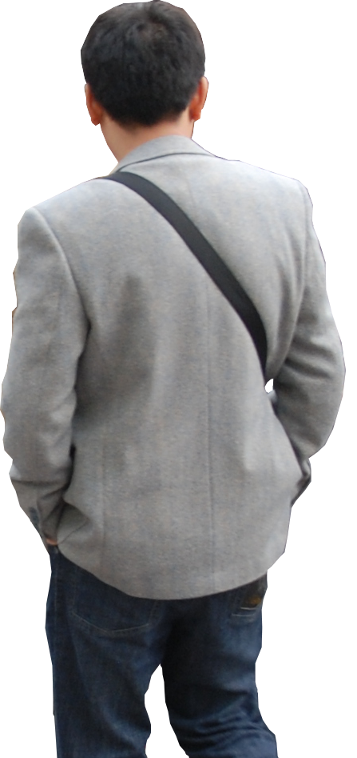
I’m not interested
Before seeing the plan
I wasn’t sure if you would be. What I want to find out is whether I can help you to ____________( reason of owning Market Australia Shop.com )

Slide 18
I’m not interested
After seeing the plan
Timing may not be right for you now.
You are welcome to be my customer and get paid to shop, it’s FREE registration.

Slide 19

YOU CAN’T TEACH WHAT YOU DON’T KNOW
YOU CAN’T LEAD WHERE YOU DON’T GO
T&C’s apply
INVESTMENT [EDUCATION]

